Slide 1


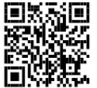
Combatting Corruption in Political Finance
Seminar on Political Funding in South Africa
18 June 2025
Dr Yukihiko Hamada International IDEA
Report available for download

Slide 2
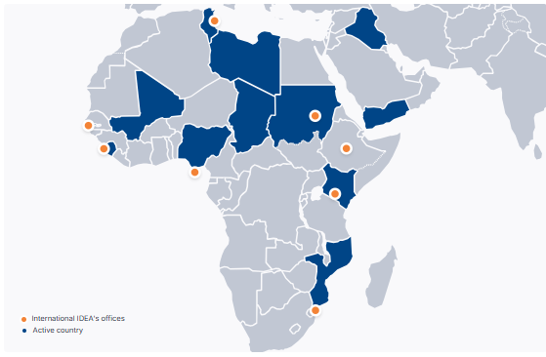
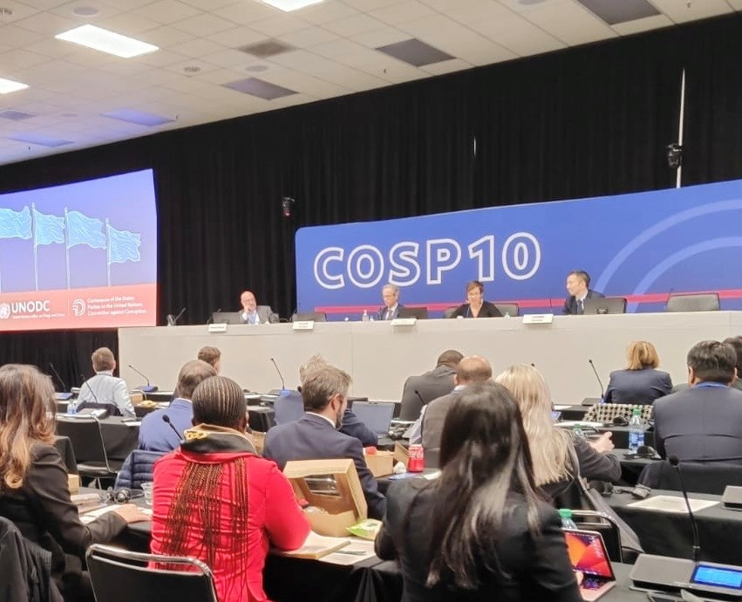
International IDEA’s work on Political Finance
30 years of supporting democracy.
Intergovernmental organization with 35 Member States — including South Africa.
Offices worldwide. HQ in Stockholm, Sweden. Active in Africa through Regional Office in Addis Ababa.
Political finance expertise: research, technical assistance, capacity building.
Political Finance Database: https://www.idea.int/data-tools/data/political-finance-database
Engagement with oversight bodies and parliaments.

Slide 3

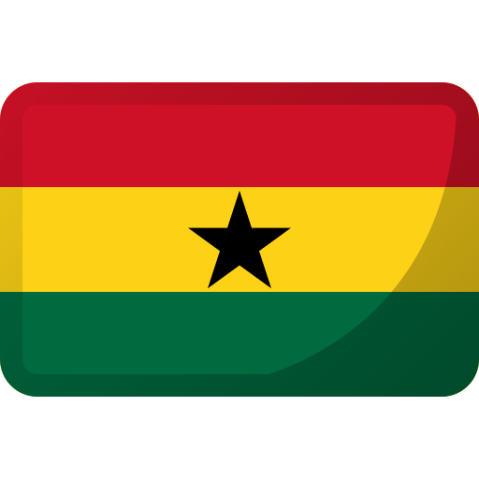
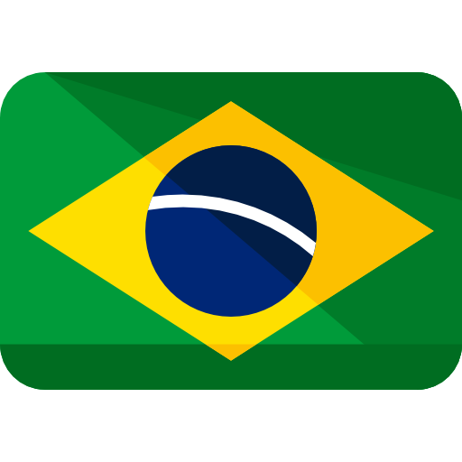

Political finance corruption is a global concern
Ghana
Armenia
Lack of transparency fuels public distrust.
Political finance breaches are often at the core of major corruption scandals.
Brazil
Japan
📌Reforming political finance systems enhances accountability and levels the playing field.

Slide 4
Types and sources of banned donations

Slide 5
Public Funding: Supporting fair and accountable politics
Around 70% of countries provide public funding to political parties.

Slide 6
Countries with spending limits

Slide 7
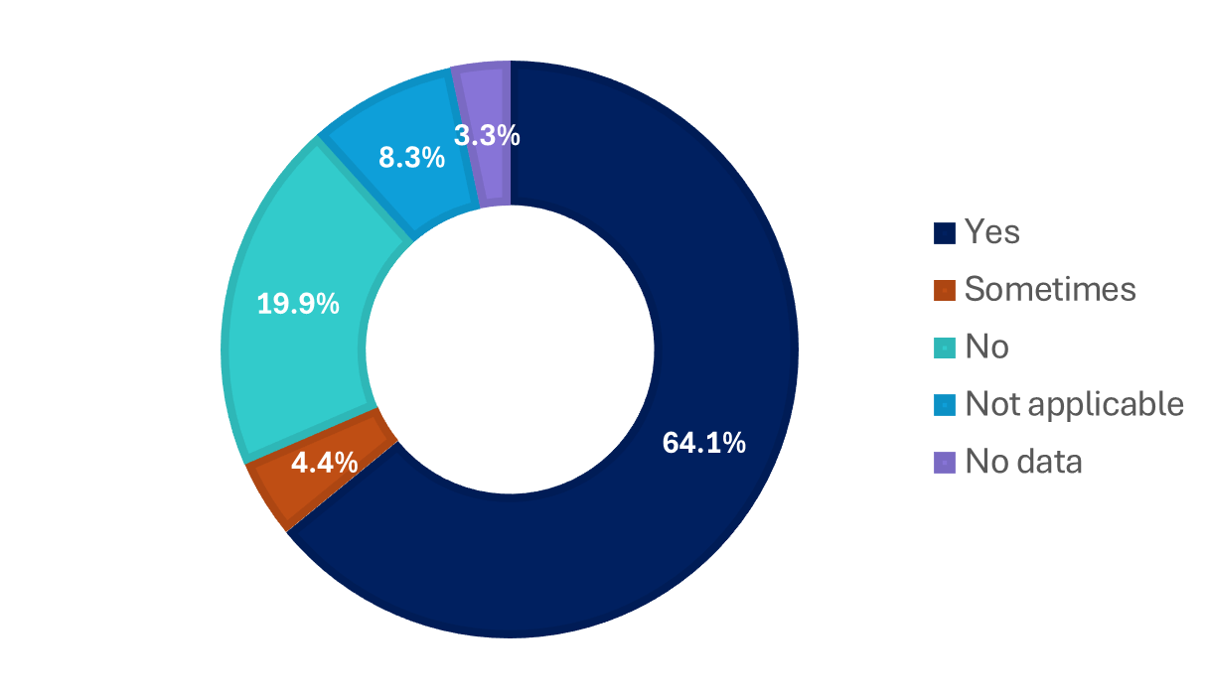

Transparency and public access to reports

Slide 8
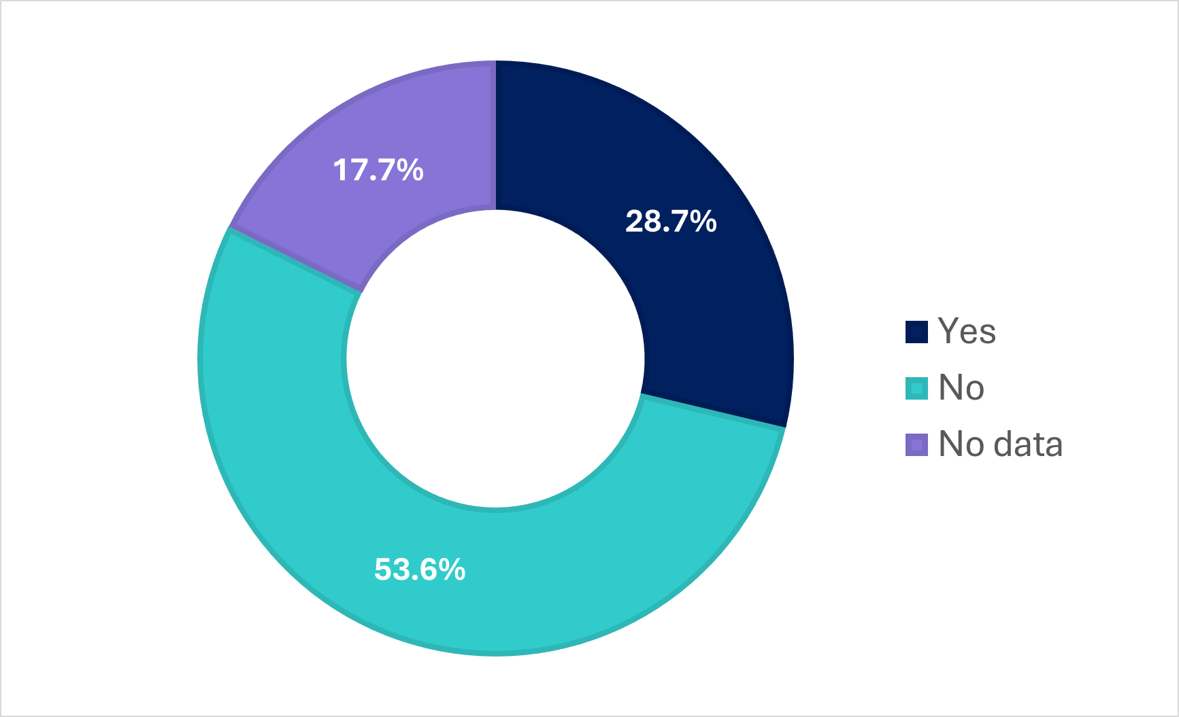
Countries with limits on third-party spending

Slide 9




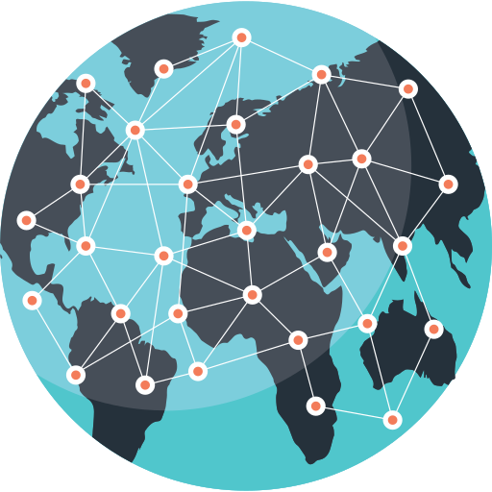



Multifaceted challenges
Enforcement challenges
Digital threats
Limited global standards
Gaps and loopholes
Illicit funding and organized crime

Slide 10
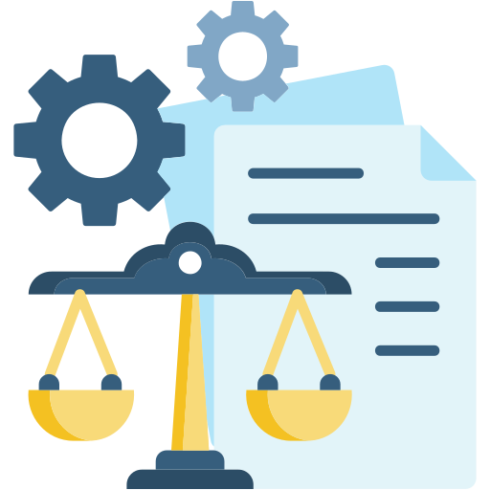



Mitigating measures
Timely regulatory reforms
Digital solutions
Interagency
cooperation
Civil society initiatives

Slide 11








What’s next?
Policymakers and oversight agencies
Political parties
Private entities
Civil society organizations and media
International actors

Slide 12
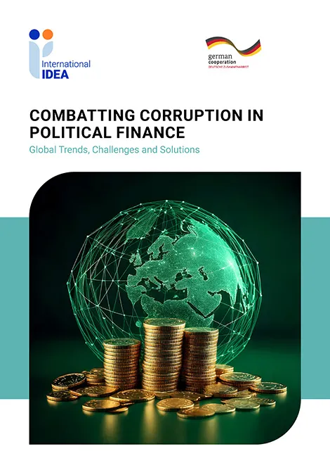
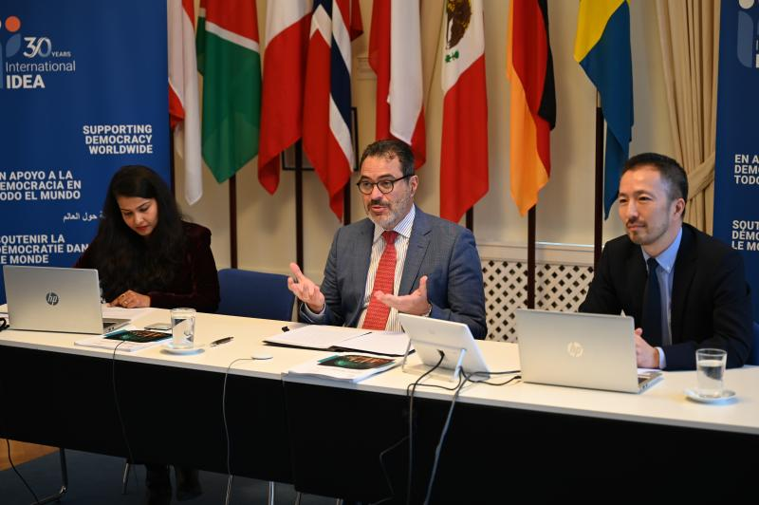
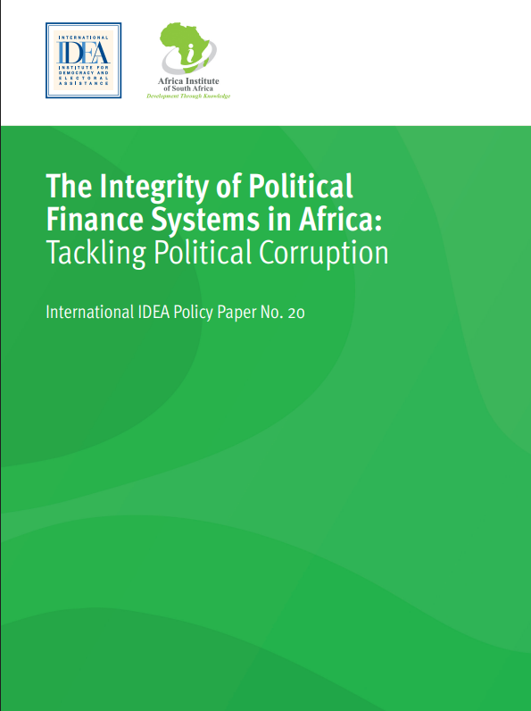
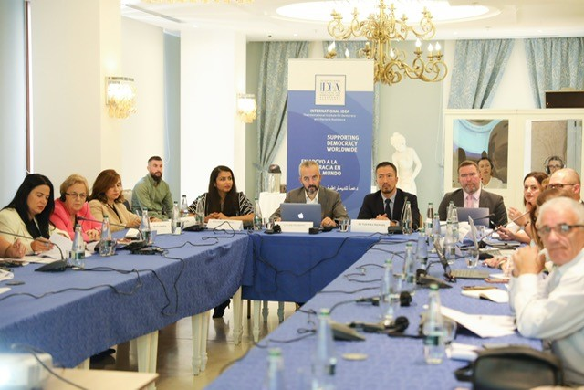
Thank you We welcome future collaboration
https://www.idea.int/theme/money-politics
https://www.idea.int/data-tools/data/political-finance-database
Contact: y.hamada@idea.int

